Slide 1

Bird Strike Analysis
This presentation analyzes bird strike data from the FAA between 2000-2011, examining the impact on aviation safety and exploring potential mitigation strategies.

Slide 2

The Problem of Bird Strikes
Bird strikes pose a significant threat to aircraft safety, potentially causing damage to structures, engines, and flight control systems. They are most common during takeoff, landing, and low-altitude flight.
Safety Hazard
Collisions can lead to severe damage, engine failure, and even catastrophic accidents.
Common Occurrences
Most frequent at altitudes below 3,000 feet, near airports during ascent or descent.
Costly Consequences
Result in expensive repairs, flight delays, and potential loss of life.

Slide 3

Data Collection and Cleaning
The dataset, obtained from a unified source, contains 25,429 records of bird strikes from January 2, 2000, to December 31, 2011. Data cleaning involved handling missing values, correcting data types, and creating new columns for analysis.
1
Data Source
Unified mentor dataset with 25,429 records.
2
Data Cleaning
Addressed missing values, corrected data types, and created new columns.
3
Data Enrichment
Created columns for year, month, day, season, and region.

Slide 4
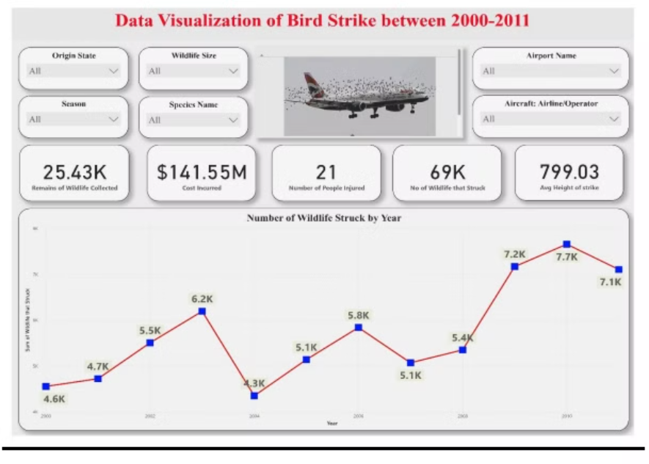
Key Insights from the Data
The average height of bird strikes is 799 feet, suggesting they occur during takeoff or landing. The maximum number of birds in a single strike was 942, with an average of 2.7 birds per strike.
Strike Altitude
Strike Magnitude
Cost of Strikes
Average height: 799 feet, indicating takeoff or landing phases.
Maximum birds in a strike: 942, average: 2.7 birds.
Cost range: $0 - $12,397,750, with a mean of $5,566 per strike.

Slide 5

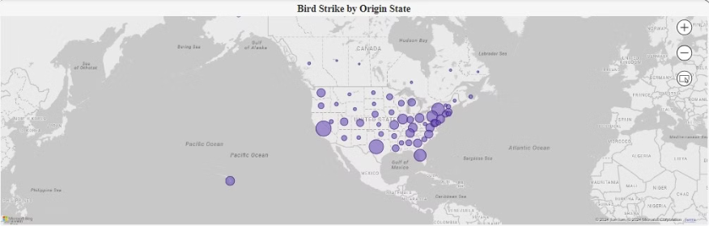
Temporal and Spatial Patterns
2010 recorded the highest number of bird strikes. California had the most strikes among states, and the summer season saw the highest frequency.
1
2
3
2010
California
Summer
Year with the highest recorded bird strikes.
State with the most bird strike incidents.
Season with the highest frequency of bird strikes.

Slide 6

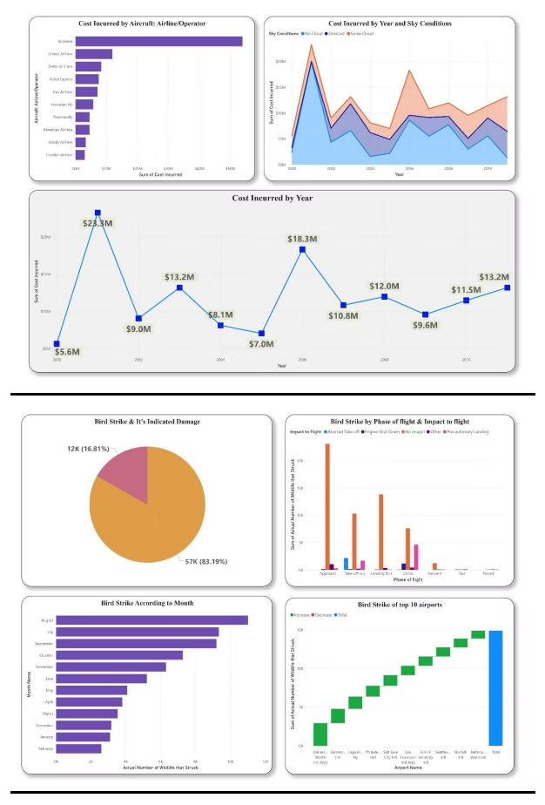



Impact and Species Involved
Most strikes didn't significantly impact flights, but some led to precautionary landings or aborted takeoffs. Canada geese and white-tailed deer caused notable damage.
Minimal Impact
Most strikes had little effect on flights.
Precautionary Actions
Some strikes led to precautionary landings or aborted takeoffs.
Notable Damage
Canada geese and white-tailed deer caused significant damage.

Slide 7

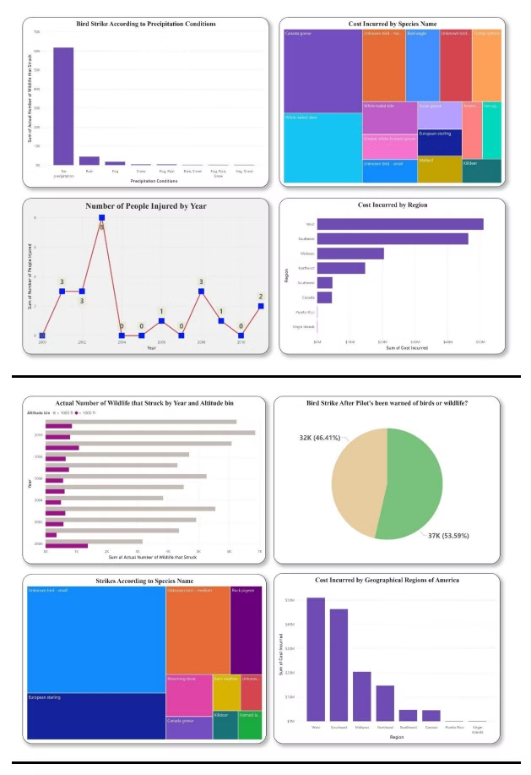



Factors Influencing Bird Strikes
Most strikes occurred during no precipitation, with rain, fog, and snow following. Dallas/Fort Worth International Airport recorded the highest number of strikes.
Weather
Most strikes happened in clear conditions, followed by rain, fog, and snow.
Airport
Dallas/Fort Worth International Airport had the most recorded strikes.
Region
Western states like California, Washington, and Arizona experienced the most strikes.

Slide 8

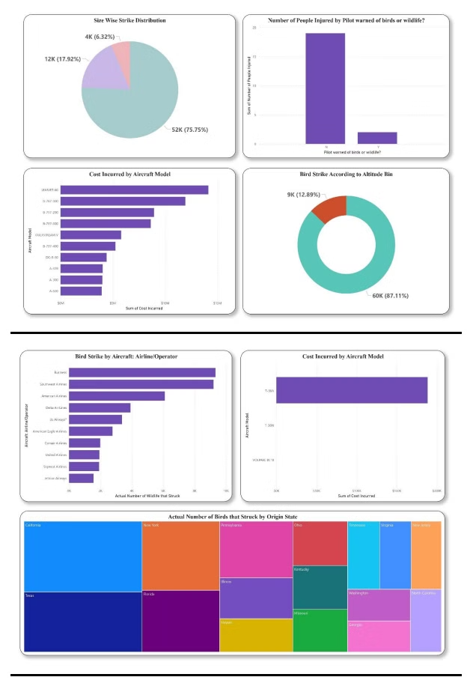
Mitigation and Prevention
Strategies include habitat management, wildlife detection systems, aircraft design improvements, pilot training, and bird deterrent technologies.
1
Habitat Management
Modify airport environments to reduce attractive food and water sources for birds.
2
Detection Systems
Use radar and other technologies to track bird activity and warn pilots.
3
Aircraft Design
Strengthen windshields and engines to better withstand bird impacts.

